Slide 1
Application’s Data Storage
Lecture 6
Tom Karni, Itsik Avidan

Slide 2
Intro
In order to resume work in our application in any time, the application data should be saved in the device memory and not in the application’s memory
Number of options :
Preferences
Files - Internal / External storage
DB
Network

Slide 3
Shared Preferences
Provide general framework that allows you to save and retrieve persistent key-value pairs of primitive data types
Can get the SharedPreferences using :
getSharedPreferances (String name, int mode)
getPrefereance(int mode)

Slide 4
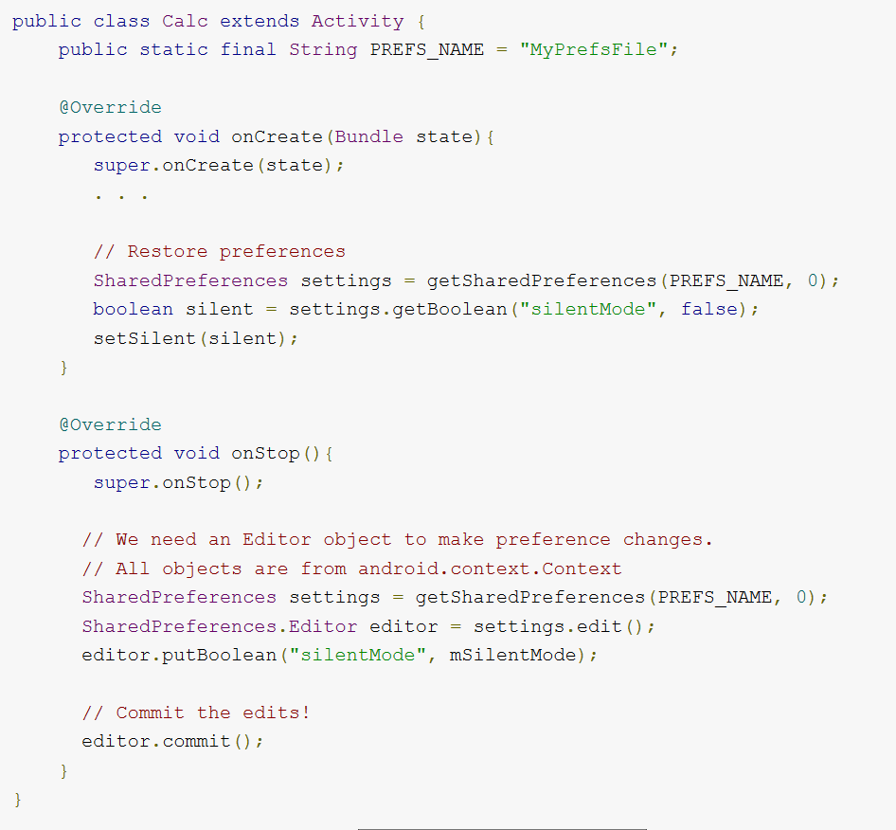
Shared Preferences

Slide 5
Internal Storage
Files saved to the internal storage are private to your application
Other applications cannot access them
When the application is uninstall, the files are removed
<project>/res/raw can store static files at compilation those files could be use for read only

Slide 6
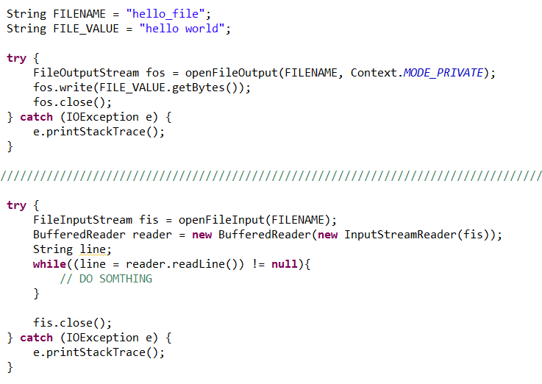
Internal Storage

Slide 7
External Storage
Removable storage media or internal storage.
Can be modified by the user
There is no security that saved file on the external storage will exists
Can be read and write by all applications

Slide 8
SQLite DB
Open Source Database which is embedded into Android
Supports standard relational database features like SQL syntax, transactions and prepared statements
Requires only little memory at runtime (approx. 250 KB)

Slide 9
SQLite DB
Android provides full support for SQLite 3 DB
DB represented in a persistence file under the Application’s installation folder
DATA/data/<app_name>/database/FILENAME
Recommended to be accessed asynchronously
Not accessible to other applications

Slide 10
SQLite DB - create
To create a DB extend the SQLiteOpenHelper.class and implement abstract methods
onCreate() – called if the DB does not exists
onUpgrade() – called if the DB version is increased, allows to update the DB schema
To read or write to DB use getReadableDatabase() or getWritableDatabase() respectably
Best practice – use the identifies _ID for the primary key of the table

Slide 11
SQLite DB – query
SQLiteDatabase is the base class for working with the DB
Provides methods to open, query, update and close the DB
SQLiteQueryBuilder – a convenience class that help to build SQL queries

Slide 12

SQLite DB - params
projection
selection
selectionArgs
groupBy
having
sortOrder
limit

Slide 13
SQLite DB - Cursor
Represents the result of a query and basically points to one row of the query result
This way Android can buffer the query results efficiently; as it does not have to load all data into memory
To move between individual data rows, you can use the moveToFirst() and moveToNext() methods
The isAfterLast() method allows to check if the end of the query result has been reached.

Slide 14
Data backup FW
The backup service allows you to copy persistent data to remote “cloud” storage
If a user performs a factory reset or converts to a new Android-powered device, the system automatically restores your backup data
Completely transparent to the user and does not affect the functionality or user experience in your application.

Slide 15
Content Providers
Lecture 5
Tom Karni, Itsik Avidan

Slide 16
Intro
Manage access to a structured set of data or File data (photos, audio or video)
Encapsulate the data, and provide mechanisms for defining data security
The standard interface that connects data in one process with code running in another process
You don't need to develop your own provider if you don't intend to share your data with other applications
Android includes content providers that manage data such as audio, video, images, and personal contact information

Slide 17
Accessing a provider
Application accesses the data from a content provider with a ContentResolver client object
This object has methods that call identically-named methods in the provider object

Slide 18
Content URI
URI – Uniform Resource Identifier
Include the symbolic name of the entire provider (authority) and a name that points to a table (a path)
content://com.bgu.cse.app.provider/table1
Content://com.bgu.cse.app.provider/table2/collection1
Content://com.bgu.cse.app.provider/table2/collection2
App package
authority
path

Slide 19
Permissions - request
Application can specify permissions that other applications must have in order to access the provider's data
To get the permissions needed to access a provider, an application requests them with a <uses-permission> element in its manifest file
When the Android Package Manager installs the application, a user must approve all of the permissions the application requests

Slide 20
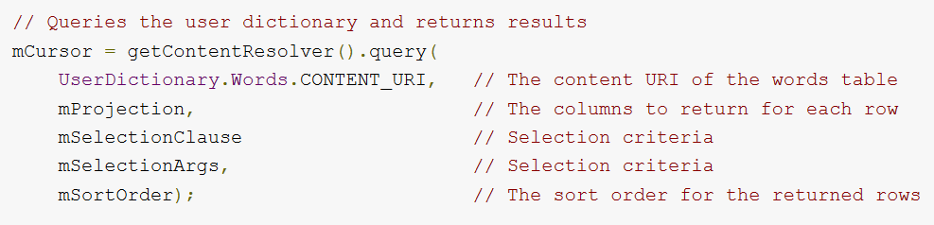
Retrieving Data
Security alert - SQL Injection !

Slide 21
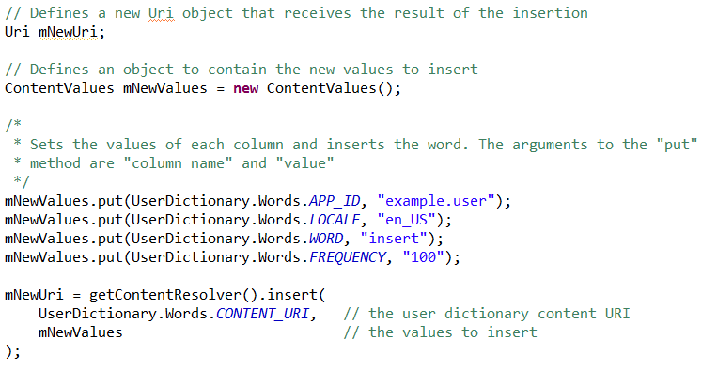
Modifying Data - Insert

Slide 22
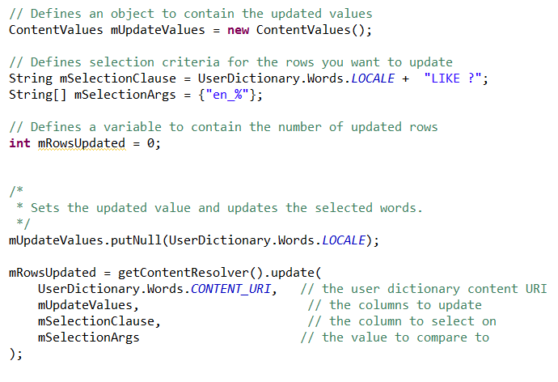
Modifying Data - Update

Slide 23
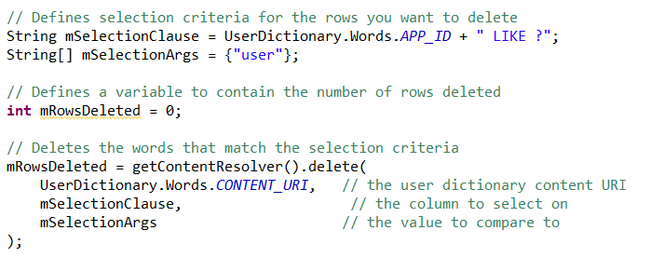
Modifying Data - Delete

Slide 24
Creating Content Provider
In-order to create a Content Provider extend the ContentProvide.class
Implement the abstract methods :
query() : Cursor
Insert() : URI
update() : int
delete() : int
getType() : MIME
onCreate()

Slide 25
Creating Content Provider
All operations should be thread safe
Avoid doing lengthy operations in onCreate()
Think about everything – the worst could happen
Preform input validations
Write good documentation
Throw exceptions

Slide 26
MIME Types
MIME type is a standardized way to define data type by giving it a unique name
Helps a ContentProvider that handles several different types of data to keep things organized
Common types of data return the standard MIME type for that data - IANA MIME Media Types

Slide 27

MIME Types
Vendor-specific MIME format
Type part: vnd
Subtype part:
If the URI pattern is for a single row: android.cursor.item/
If the URI pattern is for more than one row: android.cursor.dir/
Provider-specific type: vnd.<name>.<type>

Slide 28
Contract Class
public final class that contains constants for :
URI
Column names
MIME types
Other meta-data
Contract between the provider and other applications by ensuring that the provider can be correctly accessed even if there are changes to the actual values

Slide 29
Permissions - define
All applications can read from or write to your provider
Set permissions for your provider in your manifest file, using attributes or child elements of the <provider> element

Slide 30
References
Android developers [http://developer.android.com]
SQLite [http://www.sqlite.org/]
W.Frank Ableson, Robi Sen, Chris King. “Android in Action, 2nd edition”, 2011.

